Slide 1



Slide 2
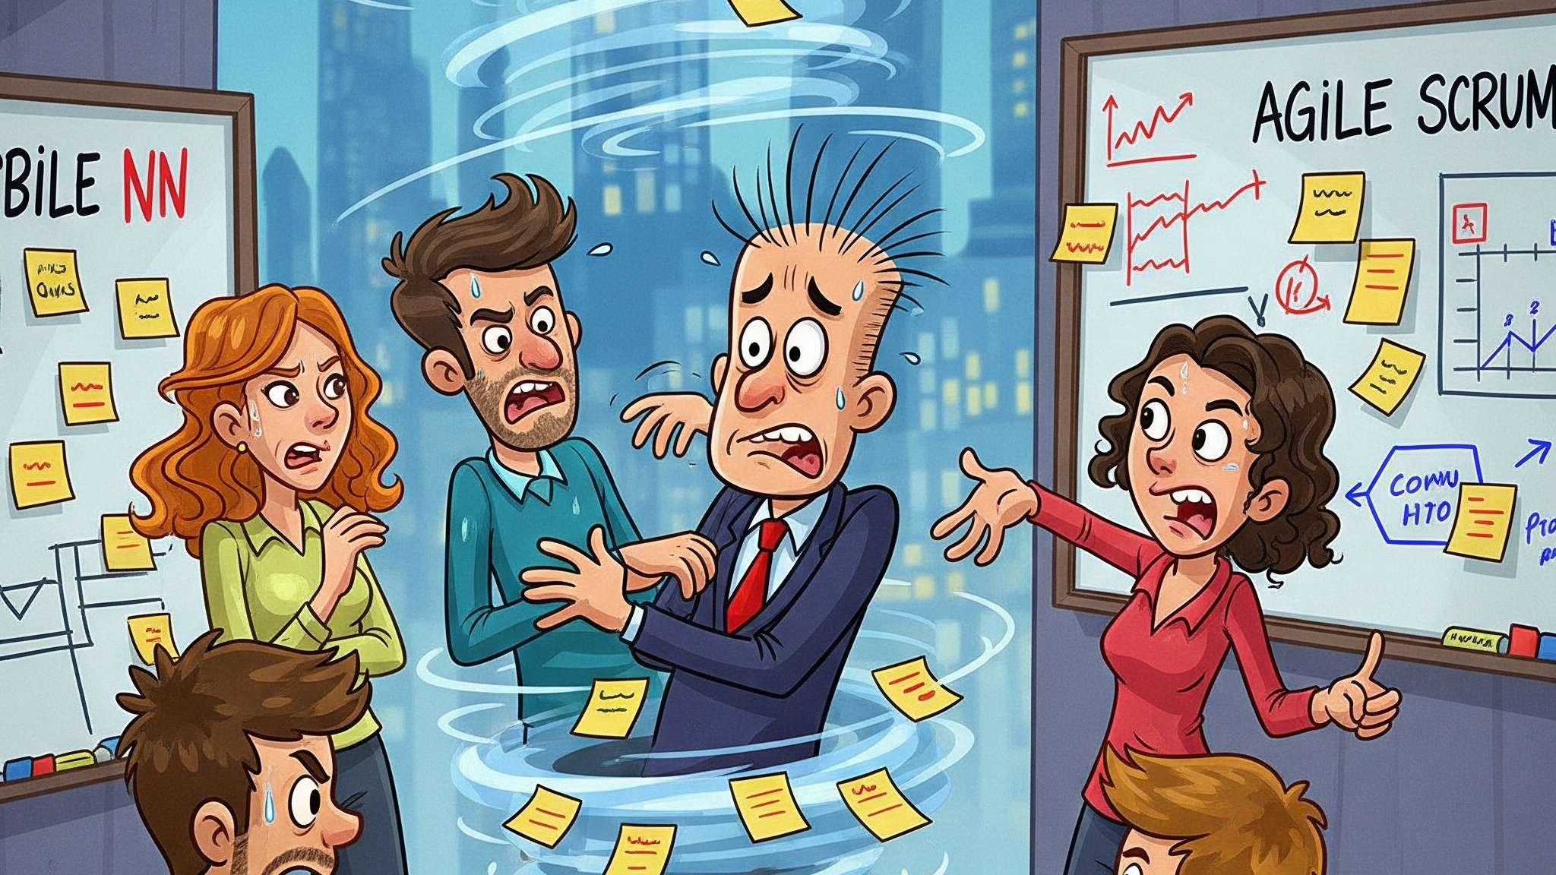

Slide 3

Ensures user stories follow AMA standards
Automatically breaks work down into tasks
Fully integrated with Azure DevOps Boards
Powerful dashboard insights

Slide 4
Demo

Slide 5

A whole new world of agile efficiency
Agile teams save $65K per year with Task Genie

Slide 6
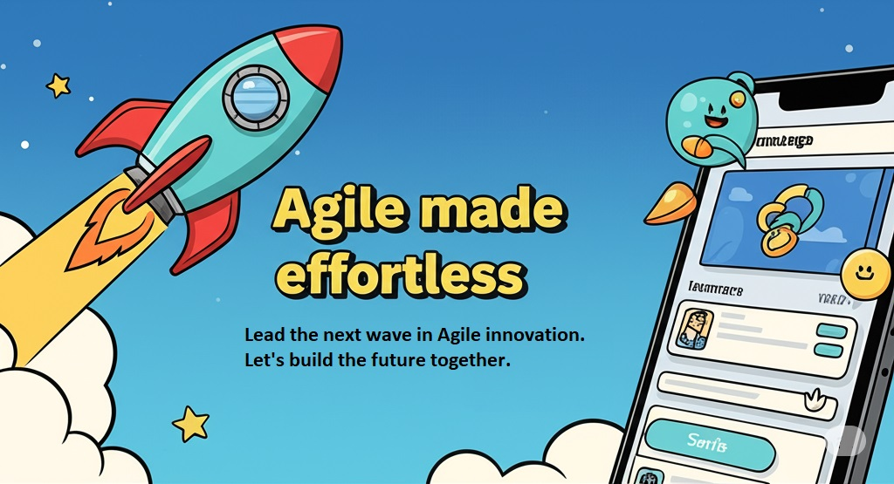

Slide 7

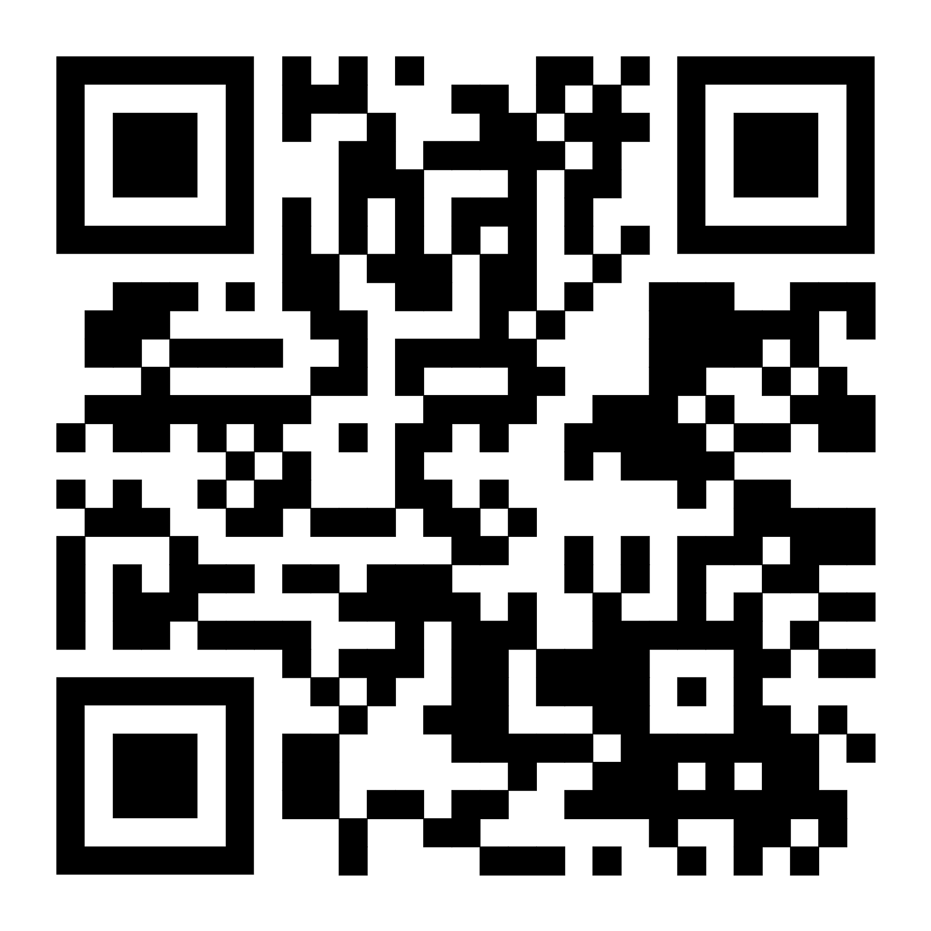
Join the game and provide your feedback now!

